Slide 1

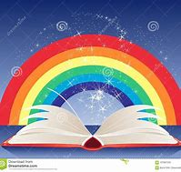
Read a Rainbow
Inspired by the rainbow motif as a symbol of hope, thanks, love, pride and solidarity, this summer we are inviting all new to NOA students to ‘Read a Rainbow’.
Each colour of the rainbow has its own reading challenge for you to complete.
As you read the rainbow, simply log your completed challenges on your own rainbow log or, if you want to create a lasting memory of your reading, create a digital or paper scrapbook of your reading rainbow.
In the first week back at school in September, hand your completed rainbow log or scrapbook into your tutor to give to Ms. Tribe (NOA’S Literacy Lead) in the English office. to receive a reward and entry into a grand prize draw.

Slide 2
Read a Rainbow
In the first week back at school in September, hand your completed rainbow log or scrapbook to your tutor to give to Ms. Tribe (NOA’S Literacy Lead) in the English office.
Everyone who hands in an entry will be awarded merits and will be invited to a Hot Chocolate Celebration Event.
At the event there will be a grand prize draw to win a £10 Voucher and a voucher will be awarded for the best entry.

Slide 3
Read a Rainbow
Here is a very quick guide to each part of the challenge.
And an example of one of our previous winners.

Slide 4

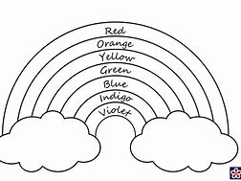
Read a Rainbow Reading Log
As you read the rainbow, simply log your completed challenges on your own rainbow or, if you want to create a lasting memory of your reading, create a digital or paper scrapbook of your reading rainbow.
Make sure you record:
The reading you did (title/author)
The date you completed it
Your thoughts on your reading
Write your name, year group and tutor on your log.

Slide 5
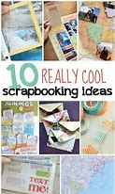
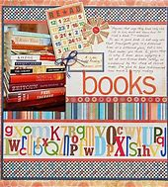
Read a Rainbow Reading Scrapbook
If you want to create a lasting memory of your reading you could create a digital or paper scrapbook of your reading rainbow. There are lots of ideas for scrapbooking on the internet.

Slide 6
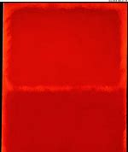
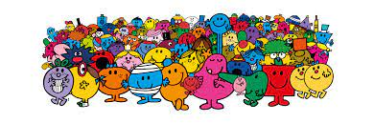

Red is for Life
Traditionally, the colour red in the rainbow represents life.
Do you remember the first story that you were told? The first that made you see the world differently? The first that you read over and over again?
The Red Reading Challenge is to re-read some of your own childhood favourites or talk to family and friends about books that they read as children.
Click on the picture of the Mr Men to listen and watch some of their stories.
Click on the picture of The Mr Men to listen to their stories.

Slide 7
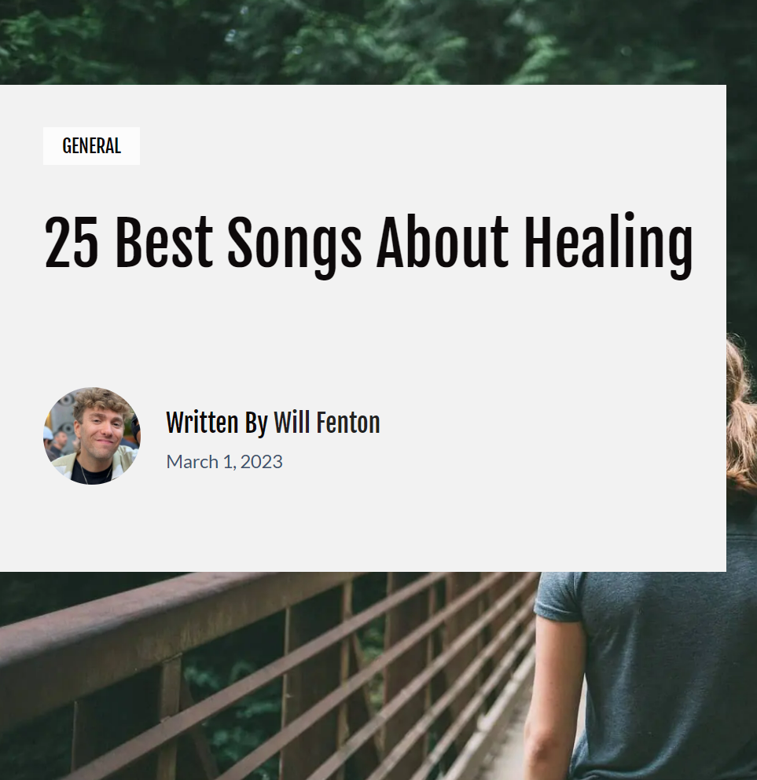
Orange is for Healing
Traditionally, the colour orange in the rainbow is a reminder of the importance of healing.
The Orange Reading Challenge is to find and read the lyrics to a song about healing.
You may want to go even further and create your own playlist for well-being.
Here is a link to a website that has some ideas: https://middermusic.com/songs-about-healing/

Slide 8
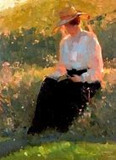
Yellow is for the Sun
Traditionally, the colour yellow in the rainbow is simply a symbol of the sun.
The Yellow Reading Challenge is to take a photo of yourself reading in the summer sunshine.

Slide 9
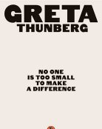
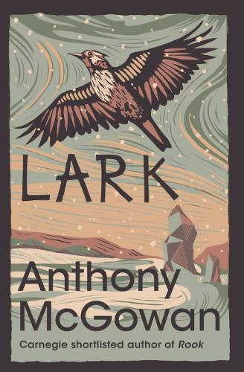
Green is for Nature
Greta Thunberg is a Swedish environmental
activist who has gained international
recognition for promoting the view that
humanity is facing an existential crisis
arising from climate change.
Anthony McGowan is a multi-award-winning author of books for adults, teenagers and younger children. He has a life-long obsession with the natural world, and has travelled widely to study and observe it. He has also written feature articles and travel journalism for The Times, Guardian, Daily Telegraph, Evening Standard and Mail on Sunday. In Year 7 your will read his book ‘Lark’ as part of your tutor time reading. ‘Lark’ is the fourth in the ‘Brock’ series. It won the 2020 Carnegie Award.
Why not read one of his other books for your Green Challenge. Don’t read Lark!
Traditionally, the colour green in the rainbow is a reminder of the power, beauty and importance of nature.
The Green Reading Challenge is to read a fiction, non-fiction or poetry collection about the environment.
Google ‘eco books for teens uk’ for lots of choices of books to read or choose one from of our recommendations.

Slide 10
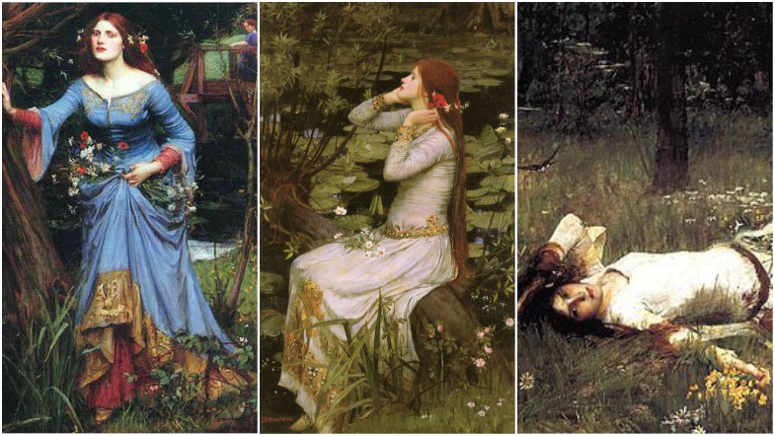
Blue is for Art
Traditionally, the colour blue in the rainbow represents art.
Books have often inspired people working in lots of different art forms from paintings of characters and scenes from books, to film adaptations of comics and novels and favourite childhood stories, to song lyrics and musicals and operas and ballets to name just a few.
The Blue Reading Challenge is to create your own piece of art inspired by something you read. You could illustrate a poem, paint a scene, compose a song, create a scratch animation- the choice is yours.
Alternatively, why not read the original of a piece of book inspired film art. For example: DC Marvel comics, The Secret Garden, Harry Potter Series or research paintings that have been inspired by books and poetry. The paintings opposite are by John Waterhouse depicting the character of Ophelia from Shakespeare’s tragedy ‘Hamlet’.

Slide 11

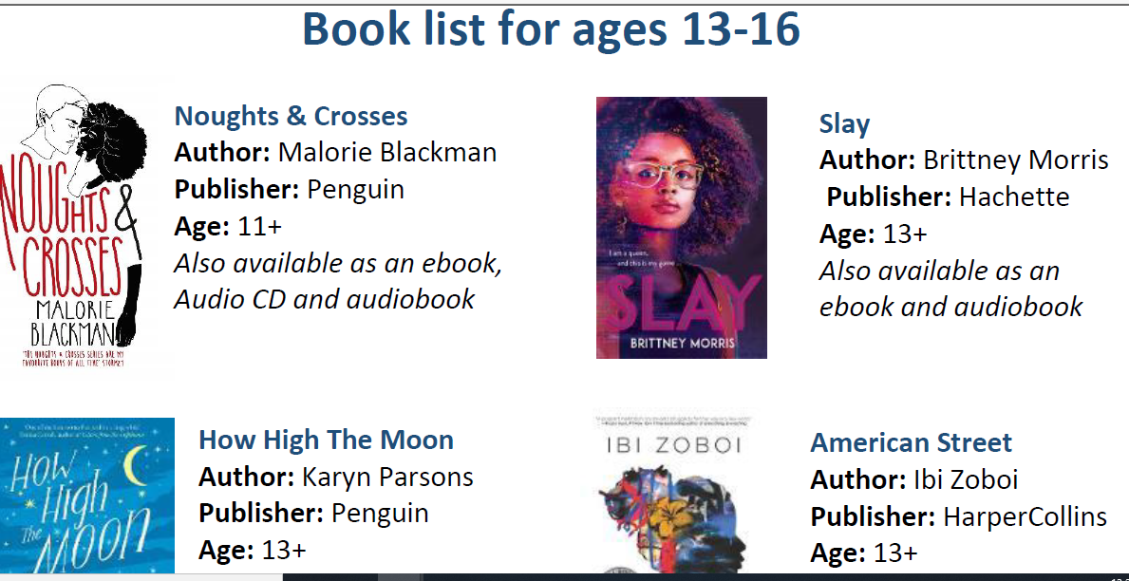
Indigo is for Harmony
Traditionally, the colour indigo in the rainbow represents harmony.
In harmony with the Black Lives Matter movement, The National Literacy Trust has brought together a series of book lists for children and young people of all ages to share black stories and promote black voices.
All books featured in the book lists are by black authors and/or illustrators and exemplify the principles of the Black Lives Matter movement.
The age-appropriate book lists have been curated to help children, young people, families and teachers explore race, identity, family and community.
The Indigo Reading Challenge is to read a book from the list.
There are 3 lists available-Ages 9-12; Ages 13-16; Ages 16 and above. https://literacytrust.org.uk/resources/black-lives-matter-book-lists-ages-0-16/

Slide 12
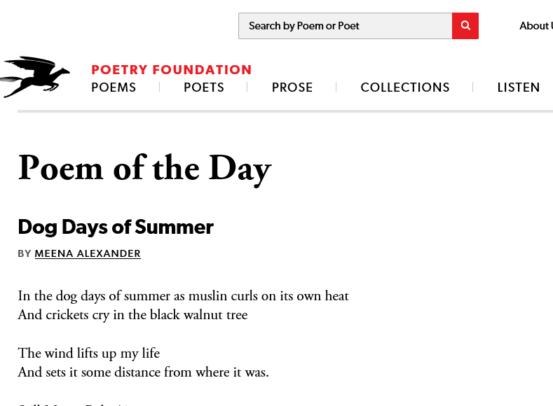
Violet is for Spirit
Traditionally, the colour violet in the rainbow represents spirit and well-being.
https://reading-well.org.uk
Reading Well supports you to understand and manage your health and wellbeing using helpful reading. The books are all recommended by health experts, as well as people with lived experience of the conditions and topics covered and their relatives and carers. It has a dedicated ‘Young people's mental health’ section as well as links to local library resources.
‘It beats like a heart, soothes emotional wounds, and builds life-giving connections.’ Rafael Campo, physician, former Harvard University teacher and award-winning author, prescribes poetry for students, patients, and doctors.
The Violet Reading Challenge is to read a book as recommended by The Reading Well Website or read a poem a day for a week. Find your own poetry collections or visit https://www.poetryfoundation.org/poems/poem-of-the-day for your daily poem.

Slide 13
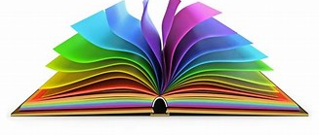
Congratulations! You have completed your Read a Rainbow Summer Reading Challenge.
Remember to complete your Read a Rainbow Reading Log and hand it or your Read a Rainbow Scrapbook into your tutor or Ms. Tribe (Literacy Lead) in the English office to receive your rewards and entry to the prize draw.

Slide 14
Read a Rainbow 2020 Winner
Here is Amelia’s winning Challenge….

Slide 15

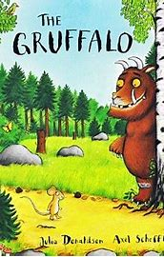
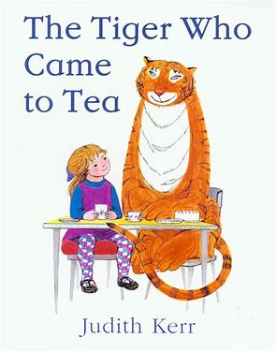
Red is for Life
The Gruffalo:
Julia Donaldson
This book was the first ever book that I remember, that I ever read, I still remember when we read it in school and when I came back I asked my parents if they can buy me it because I loved it so much.
This book was with me from the very beginning and in school we read it until year 2 and then we started reading a different book.
I really enjoyed reading this book in school or with my parents.
The Tiger Who Came For Tea:
Judith Kerr
After we stopped reading The Gruffalo we moved onto a book with a bit more words, still in year 2 and then in year 3, I also really enjoyed this reading this book when I was younger.
However I think I liked the Gruffalo more because I can remember more moments of the Gruffalo then The Tiger Who Came For Tea.

Slide 16

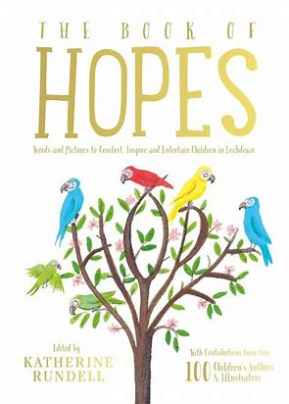
Orange is for Healing
The Book Of Hopes:
Katherine Rundell
The Creature In The Caves, Page 233-235 is a short story about a girl who went on a run with her mum her mum falls asleep so she goes exploring and finds a cave and in that cave there is a creature which she will refuse to tell any one about because she doesn’t want anyone to hurt it.
I enjoyed reading this because the person who wrote it is referring to the reader and makes a connection, I really like the idea the idea how Katherine Rundell has thought about everybody in this hard time and encouraged people to write a short story about hope.

Slide 17
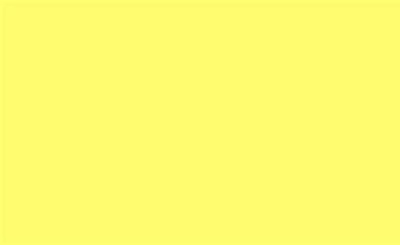
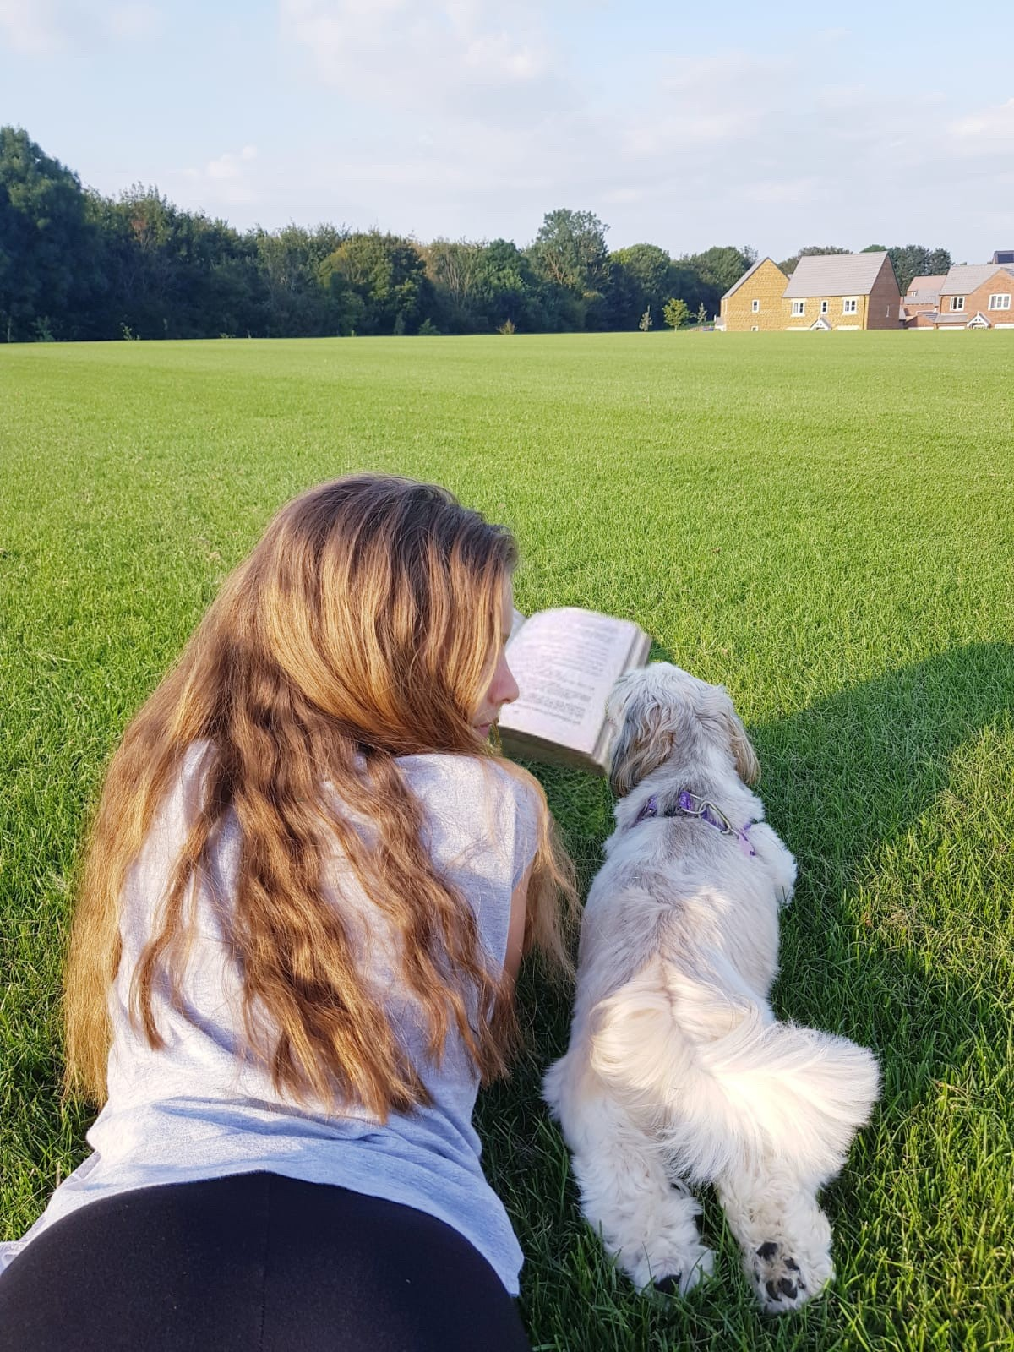
Yellow is for Sun
This is me with my dog after she ran around to much and got really tired while I was reading a book and then she came to sit next to me. It was the hottest day of the year so far it was boiling, my mum also decided to read a book with me outside and it was very relaxing.

Slide 18

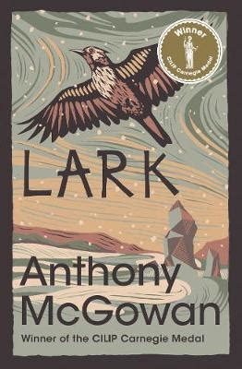
Green is for Nature
Lark:
Anthony McGowan
This is a story about two brothers who do not have an easy life. Their mother left them when they were children, and their father is an alcoholic who once worked as a miner before the mining pit was closed. One day these brothers decide to go for a walk when the weather changes and they get lost in the woods. Nicky breaks his leg, and the story of survival starts. This is a book which made me emotional to read.
This story is emotional to read because its about family, emotions, anger, its an interesting story for people who like adventure a bit of emotion.
Again this book is very sensitive and gets into the other peoples/the readers minds and feelings, the book connects itself to the readers emotions.
I enjoyed reading this book but its not my favourite I’ve read books that I liked more.

Slide 19

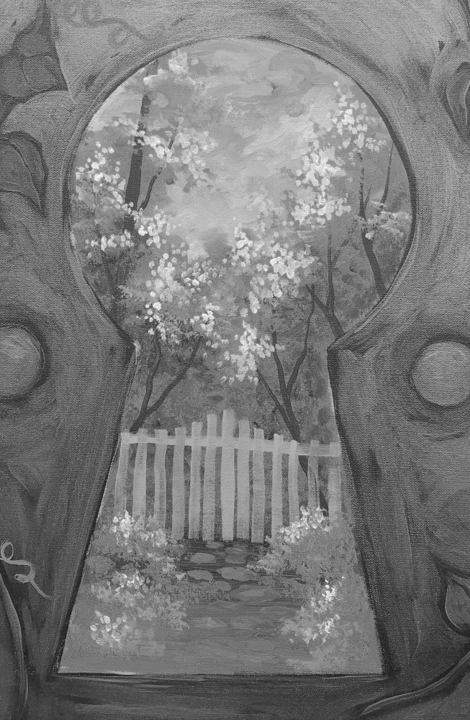
Blue is for Art
Traditionally, the colour blue in the rainbow represents art, my task was to draw something/ a scene from a book and I decided to draw something from The Secret Garden,
after I drew this I lost the drawing, which is sad. :(
The Secret Garden:
Frances Hodgson Burnett
I drew a scene from The Secret Garden, the part when they look from the key hole and see the garden that nobody has been in for years, 5-6 years ago my mum bought 2 books Black Beauty and The secret Garden, I liked The Secret Garden more, this book reminds me when I was a younger, I really enjoyed this story, adventure, excitement!

Slide 20

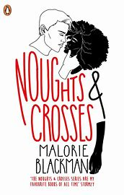
Indigo is for Harmony
Noughts and crosses:
Malorie Blackman
This novel is about a friendship between Sephy Hadley, the cross, and Callum McGregor, the nought. She’s the daughter of a wealthy politician, Kamal Hadley, who then takes office as Prime Minister. Callum is a nought. They used to play together when Jasmine, Sephy's mother, employed Meggie McGregor, Callum's mother, as a nanny. Their families, will never accept them nothing will be fair. Sephy is the daughter of Kamal Hadley, a successful and important politician who’s moving his way to the top seat in parliament.
His society wife drinks herself to not knowing what is happening. She goes to a posh school by chauffeur-driven car and doesn't really understand the discrimination and prejudice the noughts suffer. Callum knows it all too well.
I tried not to tell to much, but this story is very emotional, its got anger in it and in some places in the novel the author really speaks to the readers asking their opinion, it make you feel like part of the story, I really liked this book I think that is an important, good book.

Slide 21
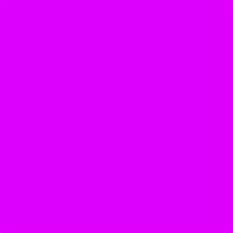
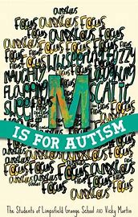
Violet is for Spirit
M Is For Autism:
Vicky Martin
Also The Students of Limpsfeild Grange School
This novel is about the reality of life with Autism
This book is very personal I would say because children are talking about their life, and their struggles, and how other people stare at them on the streets when they walk past each other. I really liked this book it made my smile on some parts.
M is for Autism shows real life experiences to create a warm and funny novel that captures the highs and lows of being different in a world of normal, children who are different but the same.

Slide 22
Read a Rainbow
The challenge is to complete the rainbow, but all entries- even if you only complete one colour will receive an award.

